Slide 2
Hyperspectral Pyrometry of Bulk Crystal Growths
Naman Parikh

Slide 3
Floating Zone Furnaces

Slide 4
Uses / Benefits

Slide 5
Physics of the Molten Zone / Models

Slide 6
Temperature is Critical Parameter

Slide 7
No one has tried probing molten zone for temperature

Slide 8
Molten Zone Temperature
Crystal Properties
Notes:
The temperature and the thermal distribution will affect the properties of the crystal we grow, but we don’t know exactly how. If we did, we could reverse engineer what we want the thermal distribution should look like during a growth. If we could have a live feed of the thermal distribution, we could compare what we have to what we want. From there we would want to know how to get what we want and how to make adjustments if needed

Slide 9
Materials Used:
Chemical Properties
Molten Zone Temperature
Furnace Controls:
Rotation Speed
Pull Rate

Slide 10
Materials Used:
Chemical Properties
Molten Zone Temperature
Crystal Properties
Furnace Controls:
Rotation Speed
Pull Rate
Notes:
Once we have the knowledge going forward, we can go backwards, using temperature of the molten zone as a middleman to figure out how to get the crystal properties we want and use that information to make adjustments in real time
Here I need to explain why this model means that we need to be able to collect temperature data in real time

Slide 11
We need real-time data

Slide 12
Research Question
How can we measure the temperature of an ongoing growth?

Slide 13
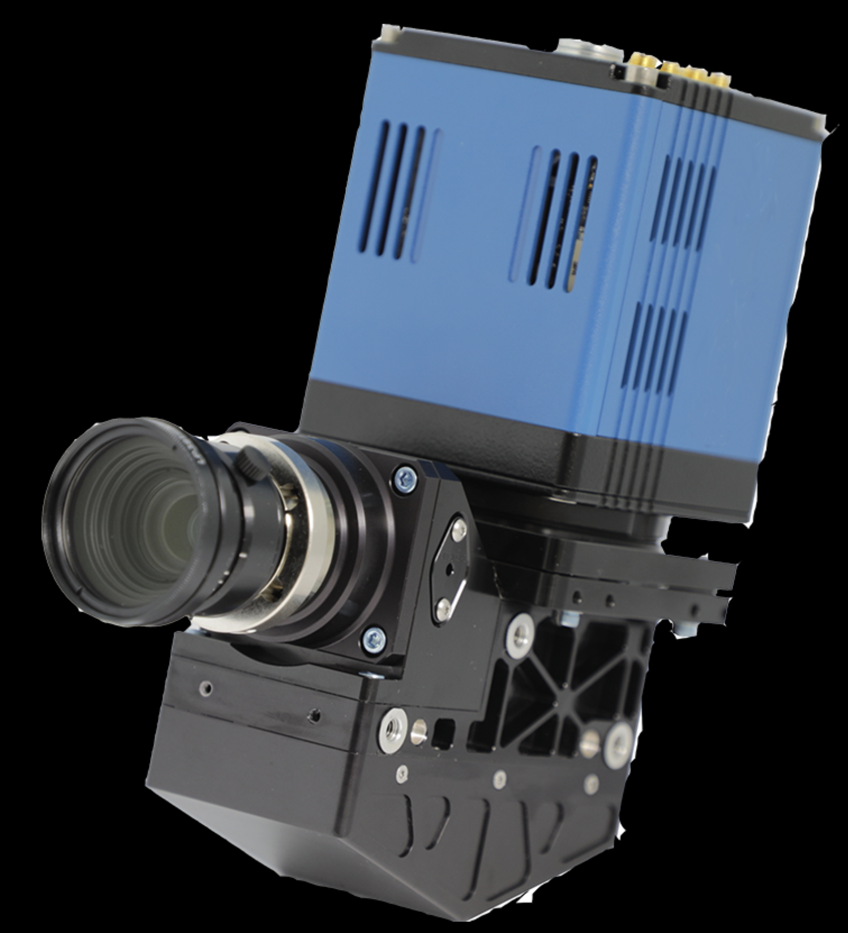
Hyperspectral Camera
Notes:
Ours is not blue :(

Slide 14
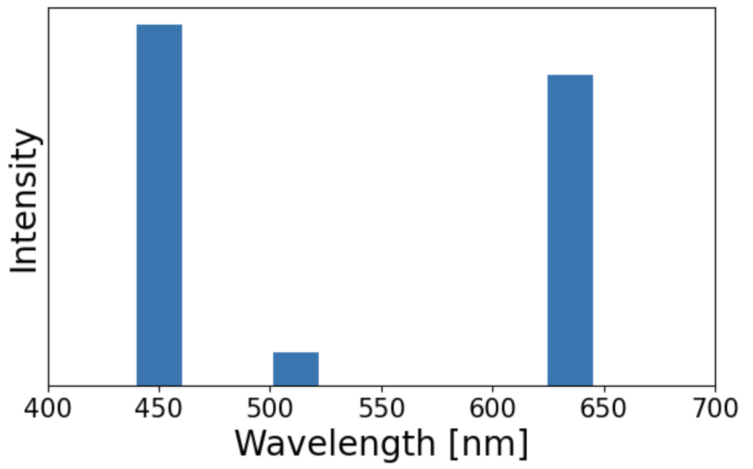
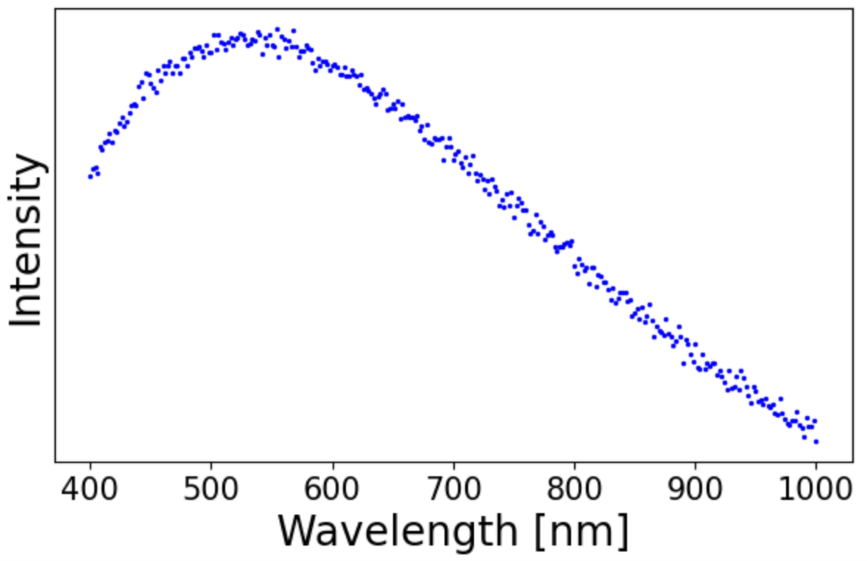
Hyperspectral
Traditional

Slide 15
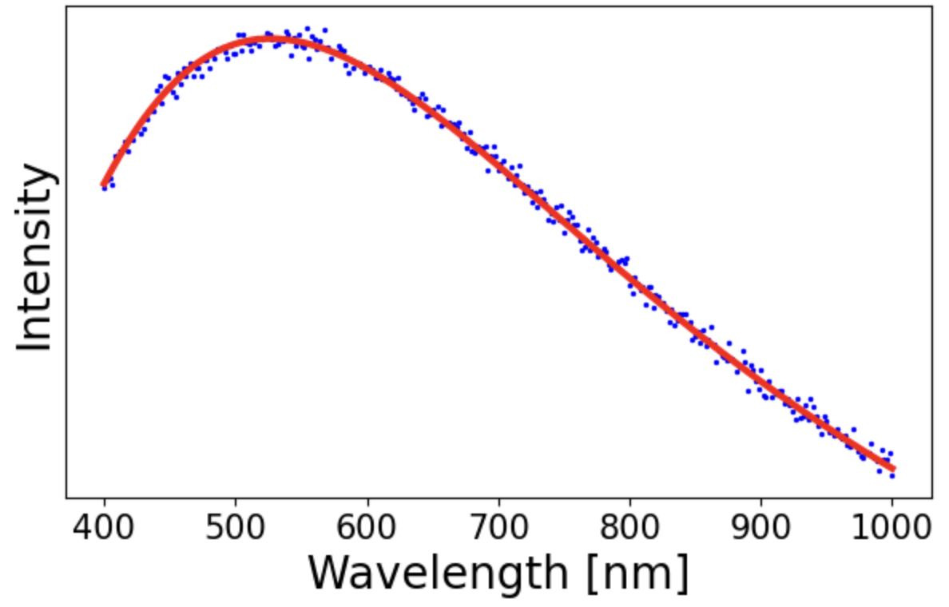
Why hyperspectral?
Notes:
With more than 3 wavelengths, we can make interpolate the data into a blackbody radiation spectrum. The exact shape of a spectrum uniquely determines the temperature, so using some machine learning on this will get us temperature values for each pixel

Slide 16
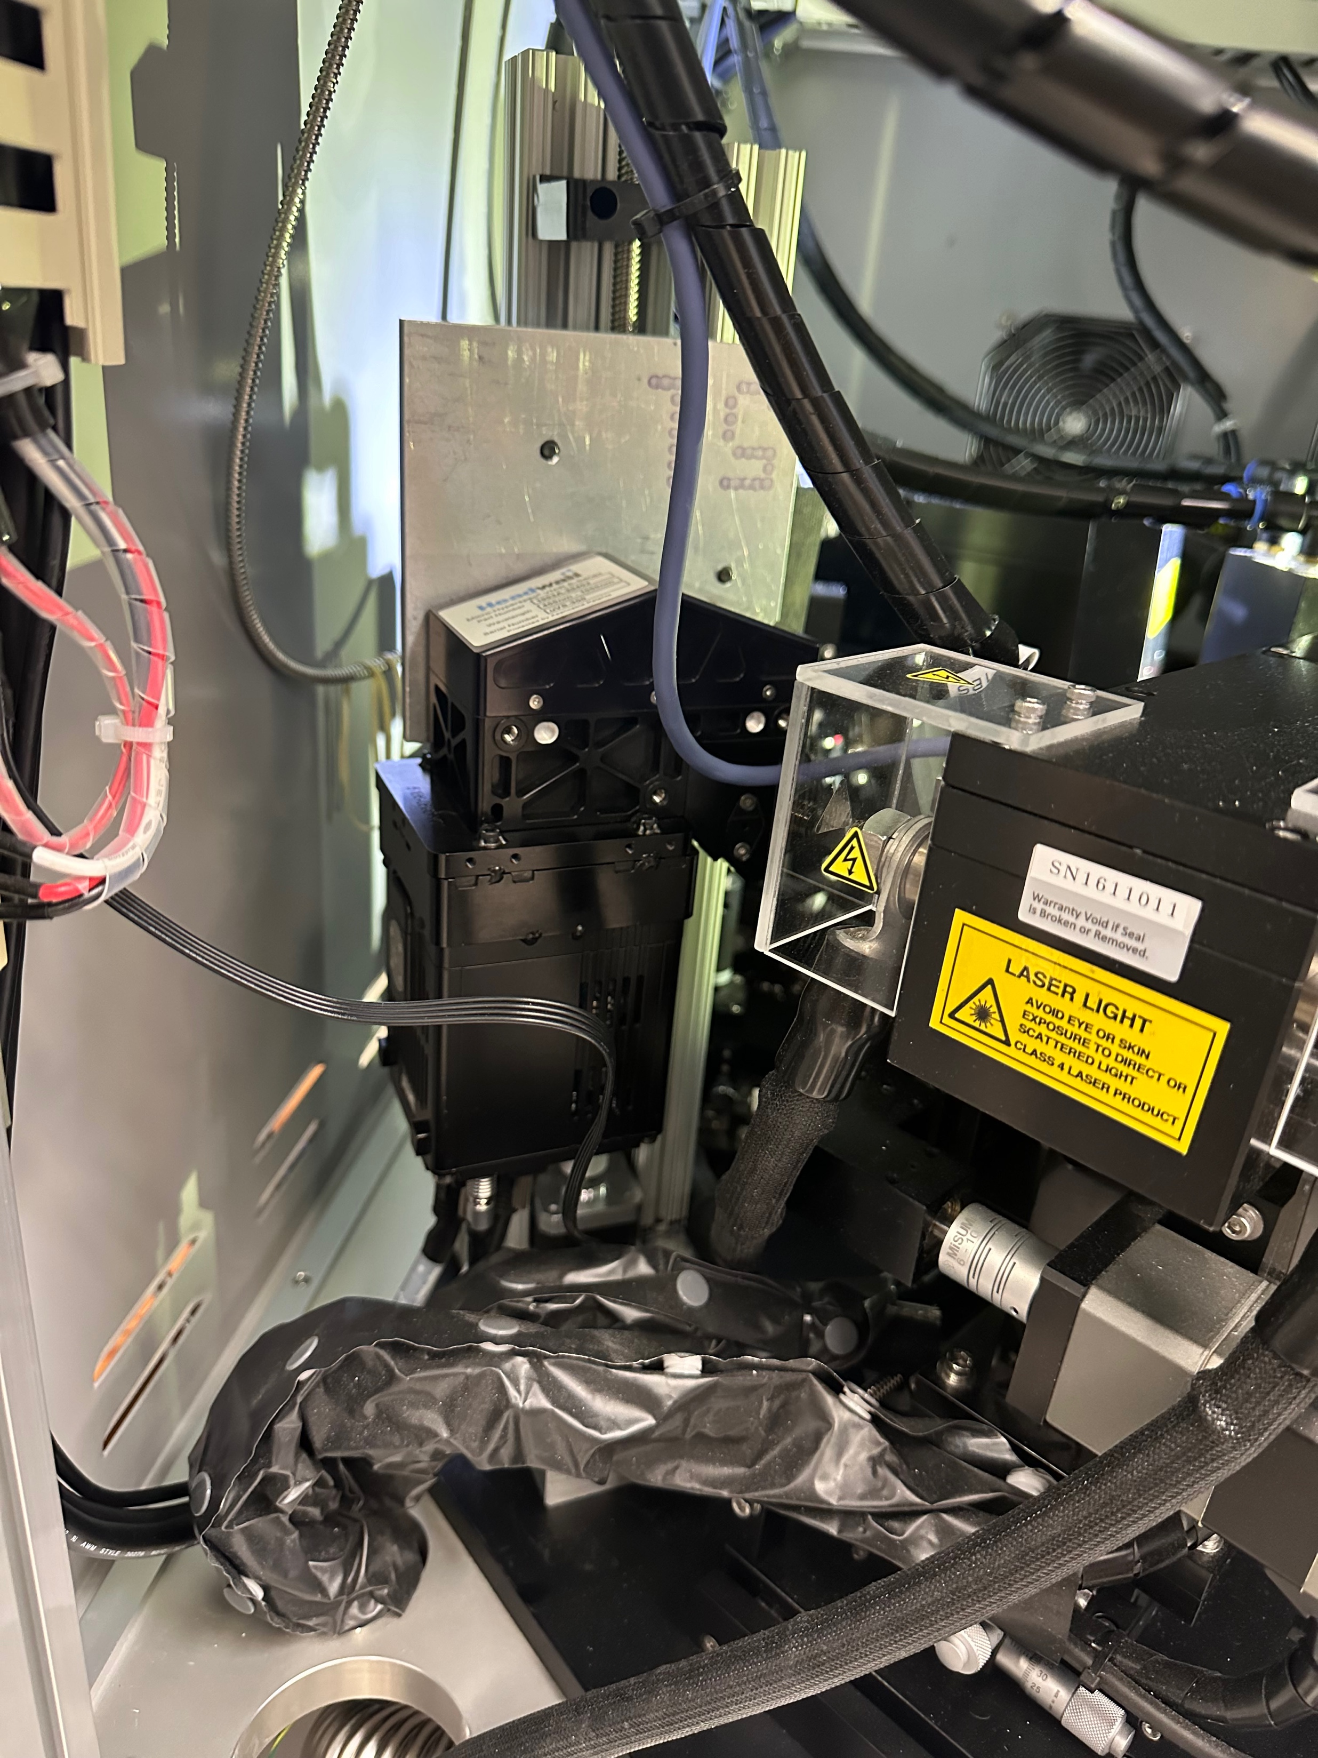
Part 1: Physical Mount

Slide 17
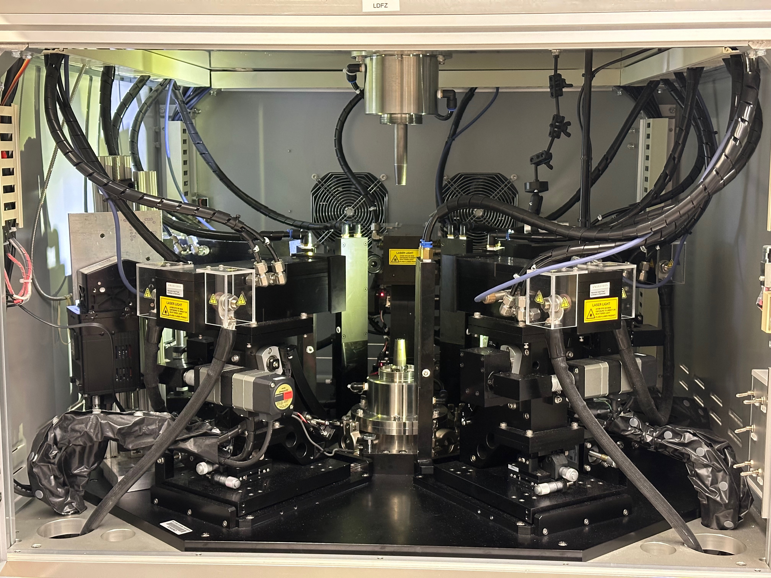

Slide 19
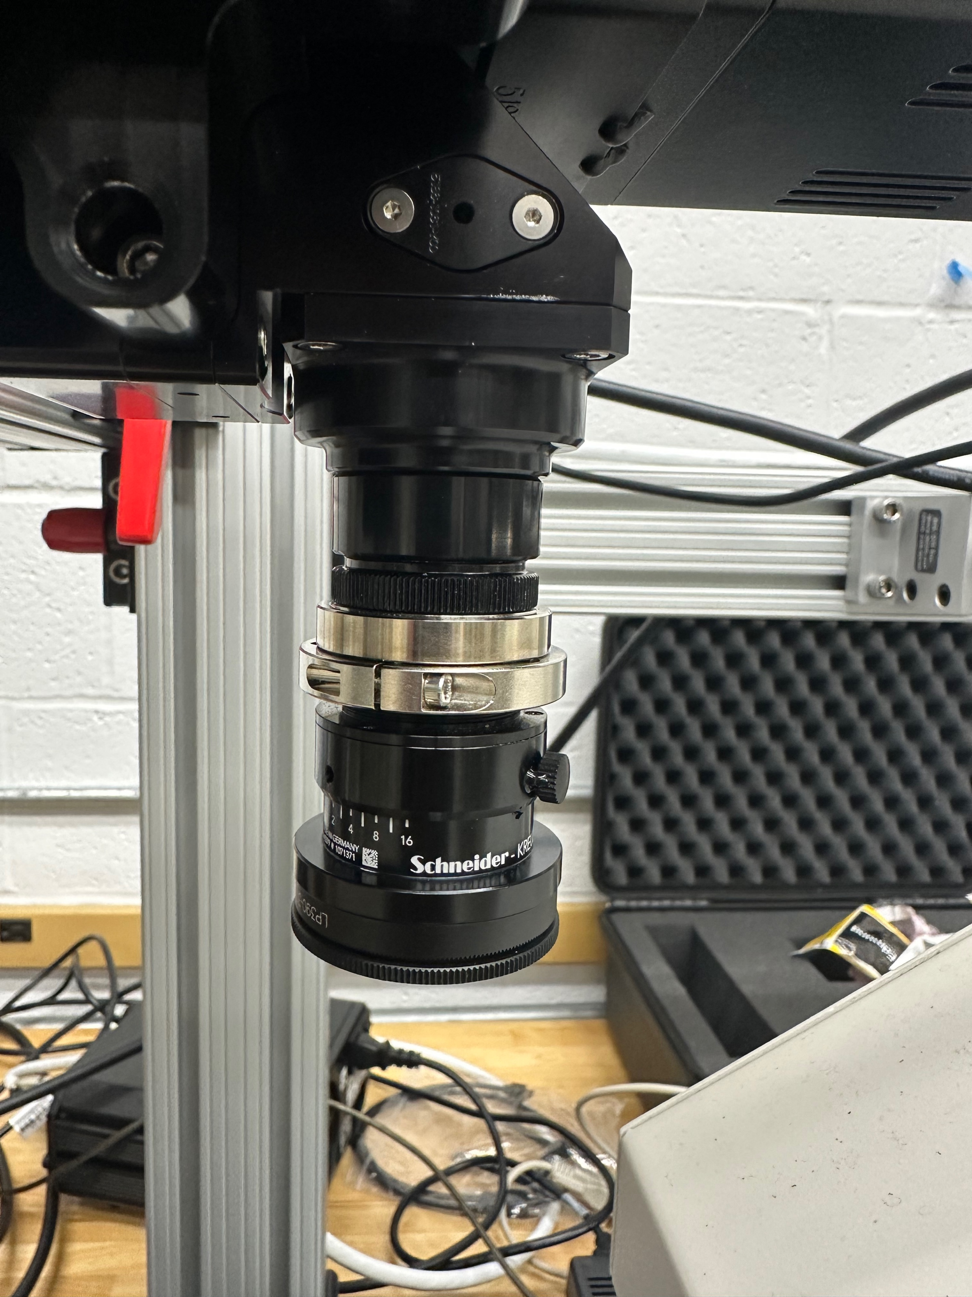
Detector
Notch Filter
Lens

Slide 20
Camera needs to move!

Slide 21
Hyperspec III and scanning stage

Slide 22
Turning the motor into the stage
Signals from stage
Computer, R-Pi, motor diagram

Slide 23
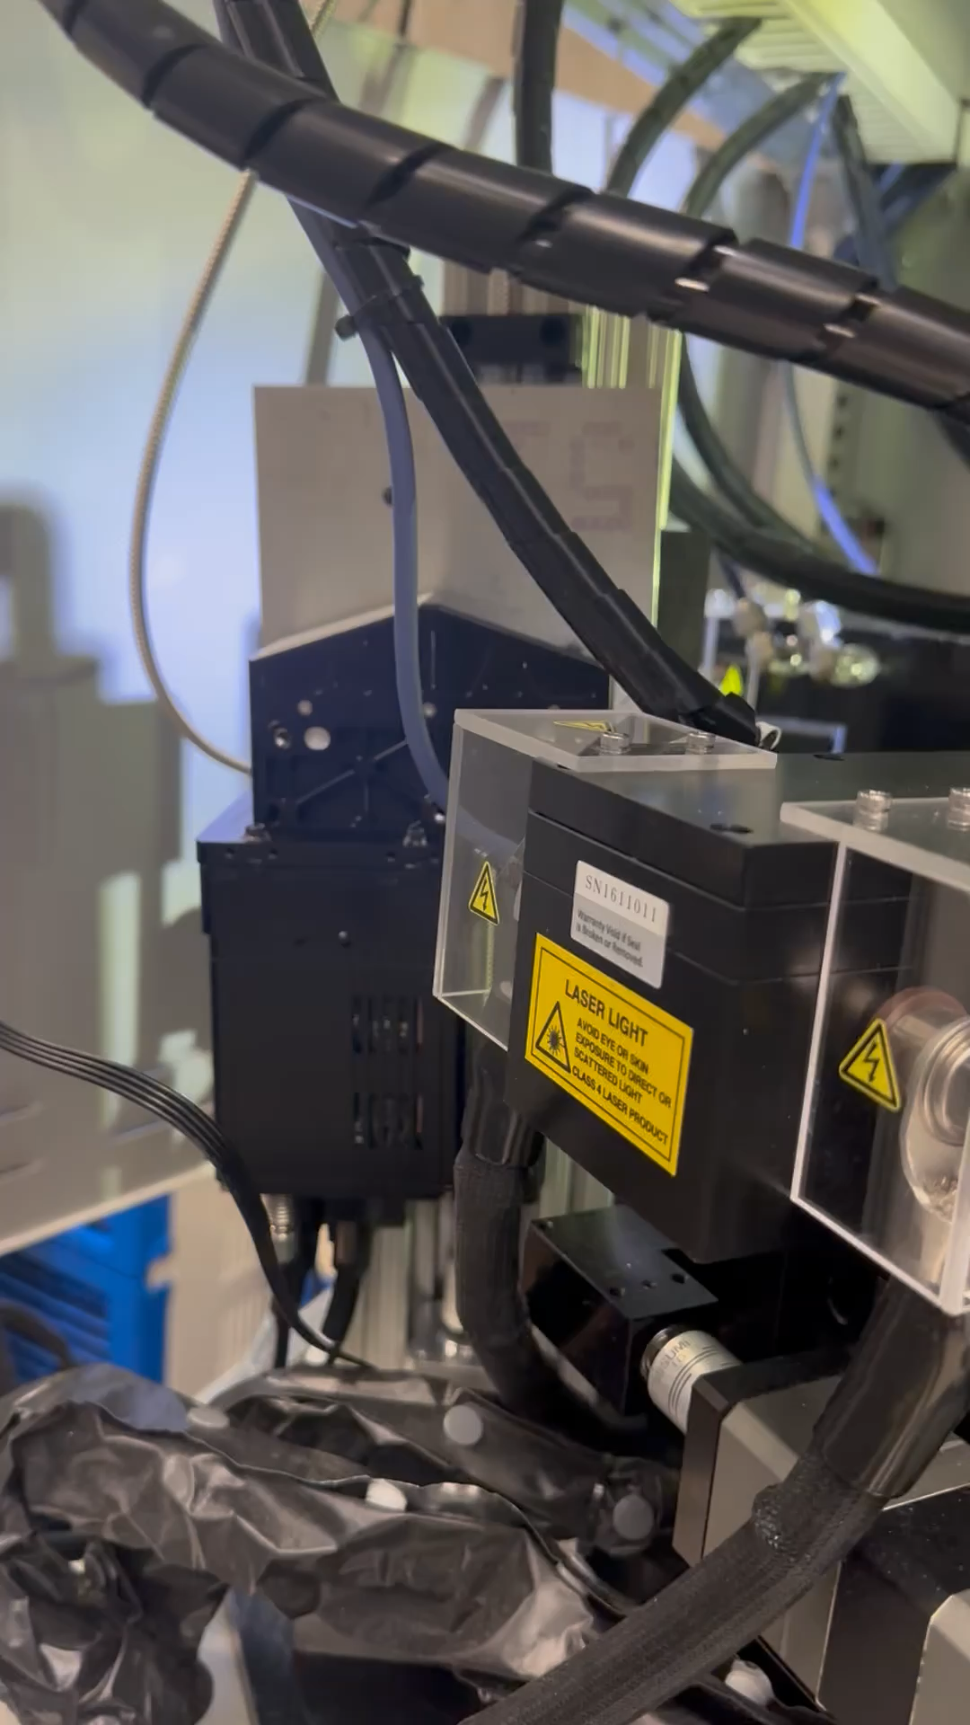

Slide 24
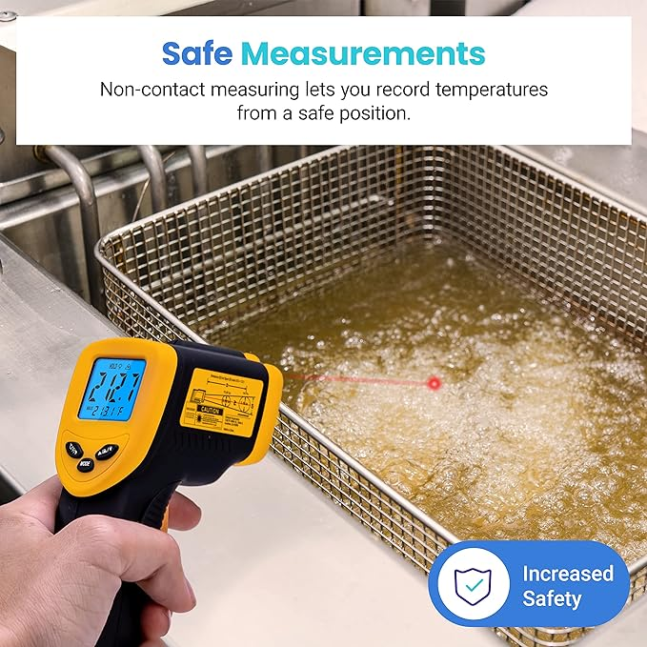
Part 2: Temperature Analysis
Etekcity Infrared Thermometer Temperature Gun 774, Digital IR Temp Gun for Food, Cooking, BBQ, Pizza Oven, Reptile, Griddle Accessories, Non Contact Surface Outdoor Heat Gun

Slide 25
Molten zone is a black-body
5500 K
Notes:
The shape of the black-body spectrum is unique to the temperature (for example, the wavelength of the peak), so we can determine temperature using the spectrum measured by the camera

Slide 26
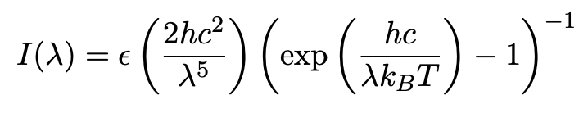
Notes:
Wavelength will be the independent variable, epsilon is emissivity

Slide 27
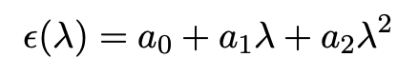

Slide 28
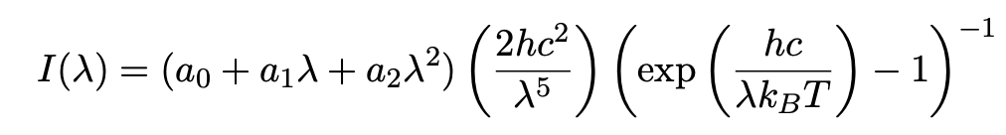

Slide 29
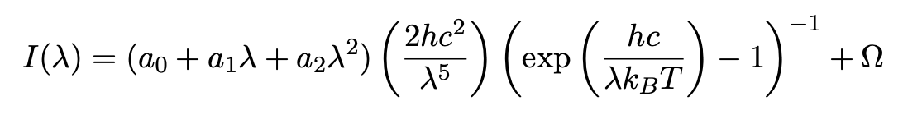

Slide 30

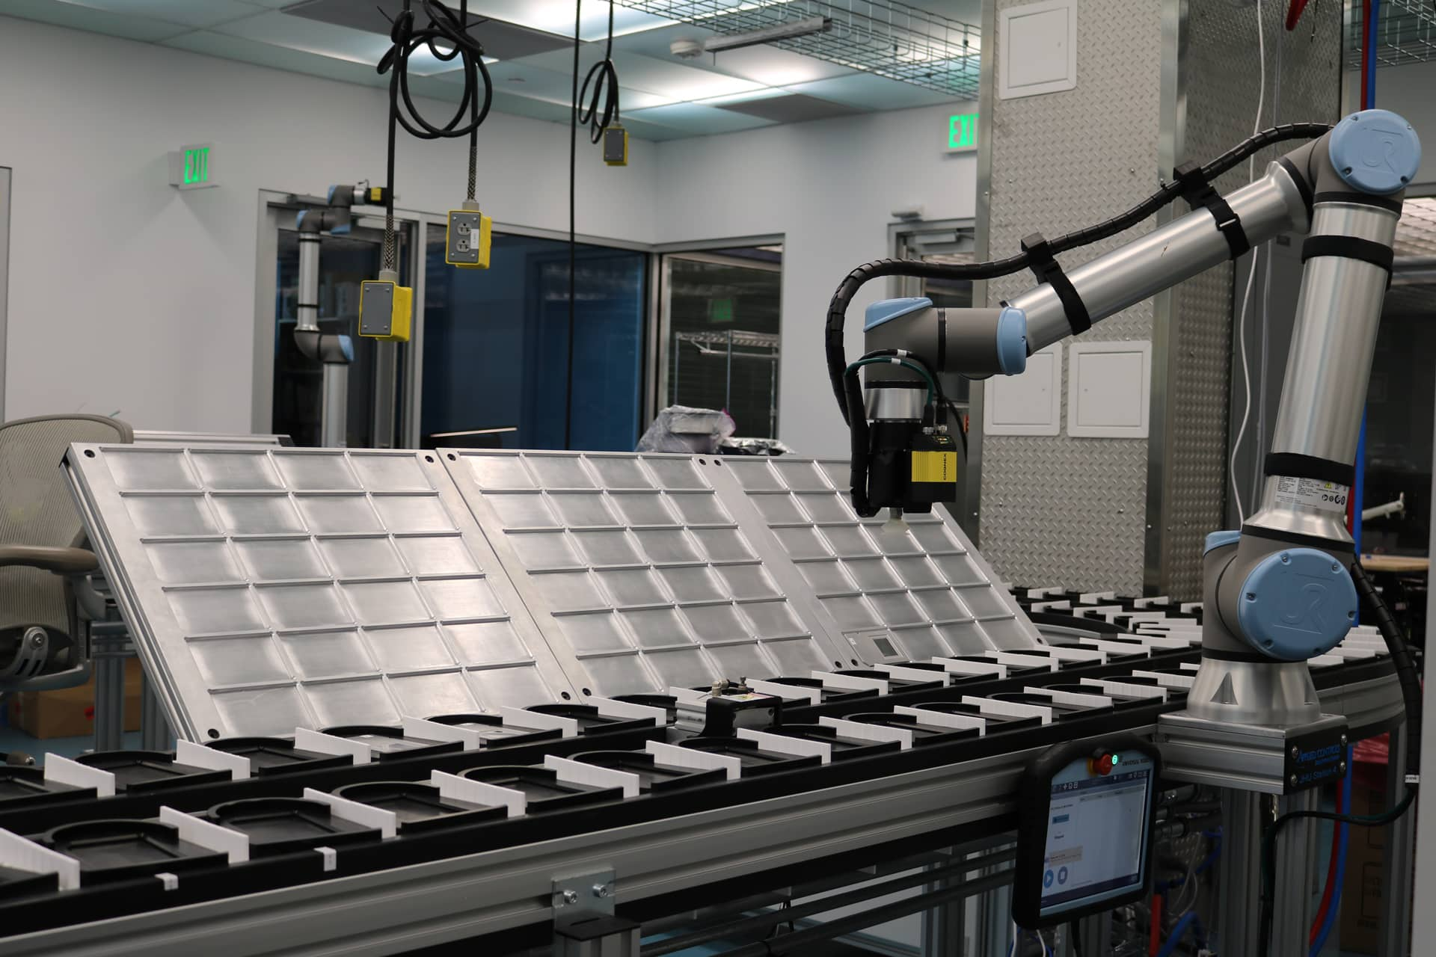
Part 3: Everything Automatic

